Slide 1
Design and implementation of MIMO for B5G in non-uniform phase Nakagami-m fading environment
ECE 3261: Communication Networks Lab

Slide 2
Group 6
Abhimanyu Borthakur
180907742
ECE- D
Roll No. 53
Sanjana Rai
180907730
ECE- D
Roll No. 51
Siddhartha Dange
180907606
ECE- D
Roll No. 43

Slide 3
Problem Statement
To design and analyse a MIMO network over a Nakagami-m fading environment with non-uniform phase distribution.
In existing literature, the assumption of Nakagami-m having a uniform phase distribution is made in order to study large- scale MIMO. The results must demonstrate clearly how the performance varies between uniform and non- uniform phase distributions.

Slide 4
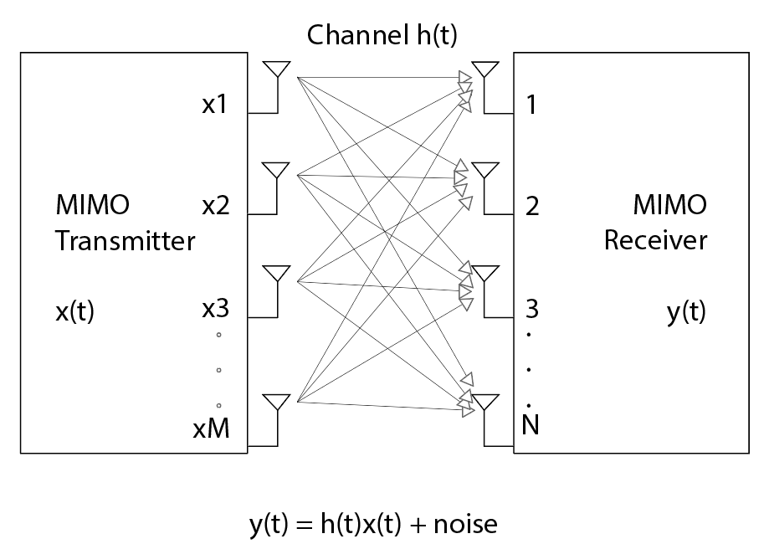
Introduction
B5G (Beyond 5G) networks have their own demands for higher data rate and higher capacity.
In this project, we design a MIMO system with a Nakagami-m non-uniform phase channel that maximises efficiency and minimizes the BER with respect to SNR.
Tool used: MATLAB

Slide 5
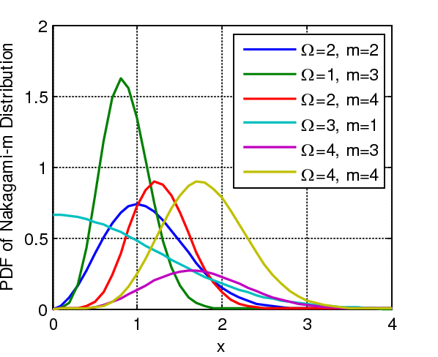
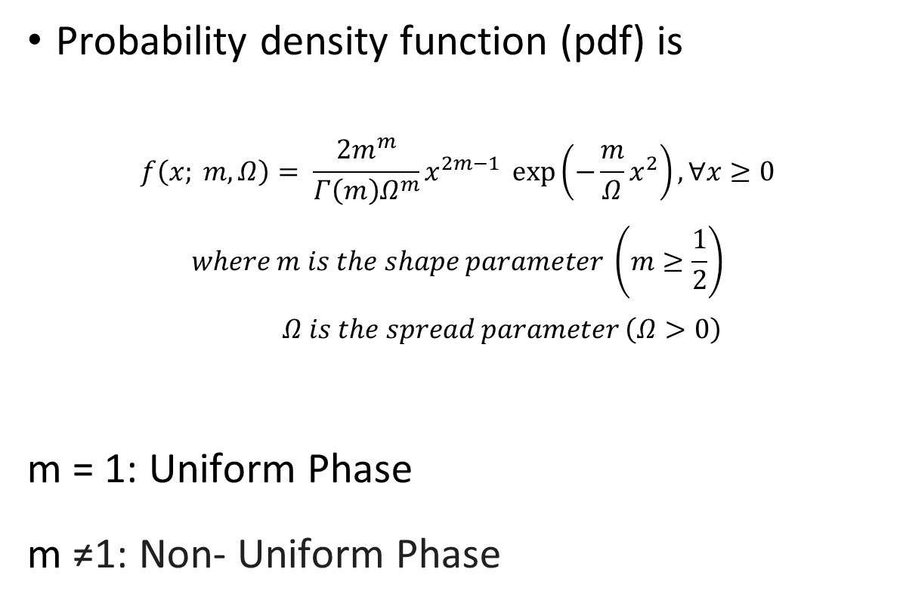
Nakagami-m Channel
Probability density function (pdf) is
$$f\left(x; m,Ω\right)= \frac{2m^{m}}{Γ\left(m\right)Ω^{m}}x^{2m−1} \exp\left(−\frac{m}{Ω}x^{2}\right), ∀x≥0$$
$$where m is the shape parameter \left(m≥\frac{1}{2}\right)$$
$$Ω is the spread parameter \left(Ω>0\right)$$
m = 1: Uniform Phase
m ≠1: Non- Uniform Phase

Slide 6
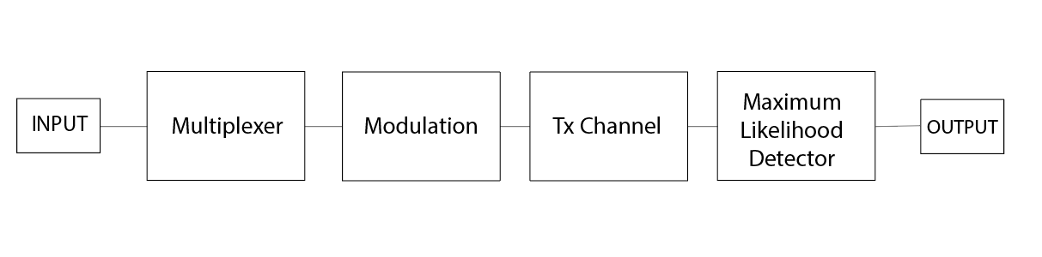
System Model
For the model designed in this project, N_{t} = N_{r} = 4.

Slide 7
1. Multiplexing
A block of k bits where
k = N_{t}log₂(M),
is demultiplexed into N_{t} branches with log₂(M) bits each.
In this model M=4.
Therefore, k = 8 and each branch receives 2 bits.

Slide 8
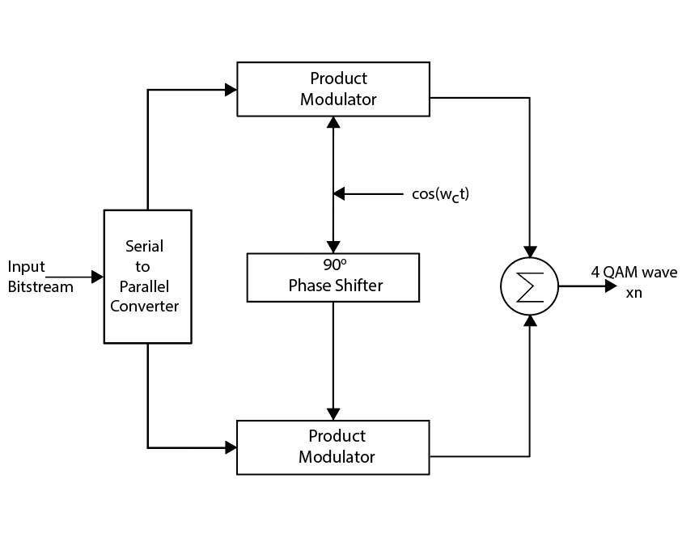
2. Modulation
The outputs from each branch of the multiplexer are then modulated using 4- QAM.
The output of modulation is stored in a vector x_{Nt x 1}, i.e.,
x = [x₁ x₂ …. x_{Nt}]^{T}.
A single QAM unit

Slide 9
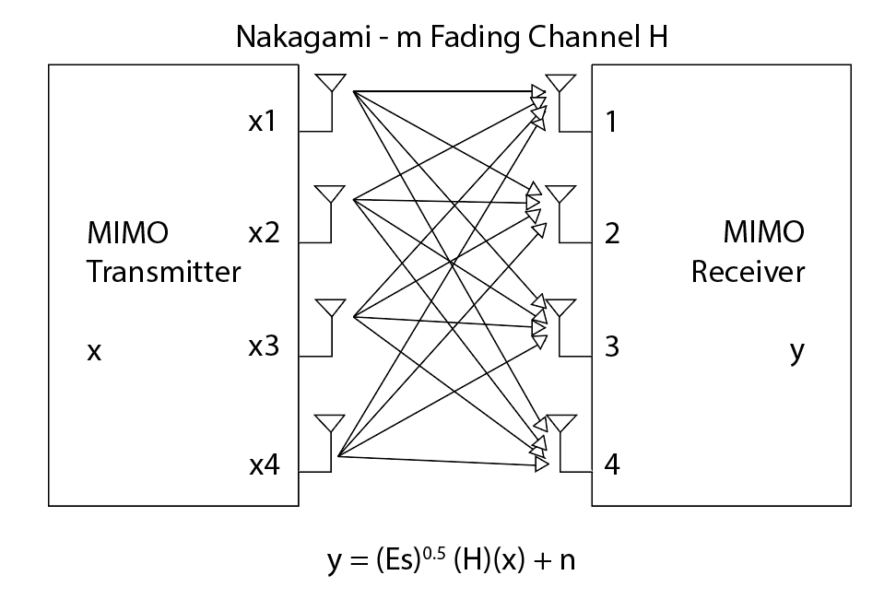
3. Transmission over fading channel
The N_{r} x 1 received vector y,
y = (Es)^{0.5}(H)(x) + n
where Es is the
overall transmitted energy.

Slide 10
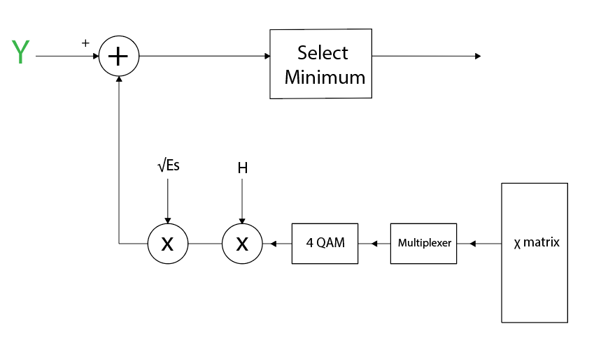
4. Maximum Likelihood Detection
The criteria for detection is
x̂ = arg min ∥y - √EsHx∥²
x∈χ
∥.∥ = Frobenius norm
χ = set of all possible combinations of data symbols and transmit antennas.
x̂
-
Maximum Likelihood Joint Detector

Slide 11
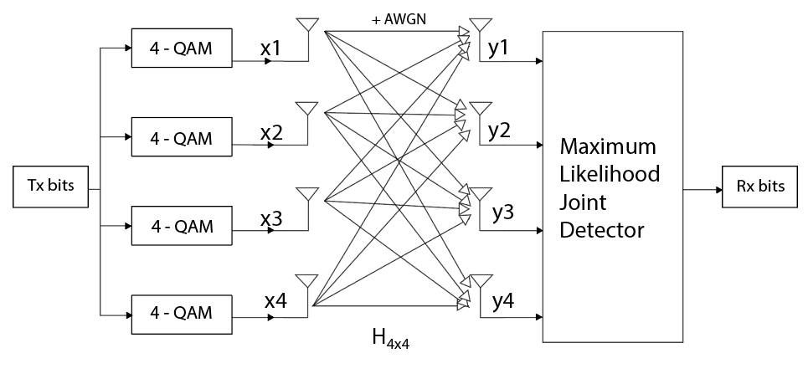
System Model
(2500)
(2500)
(10000)
(2500)
(2500)
y = (Es)^{0.5}(H)(x) + n

Slide 12
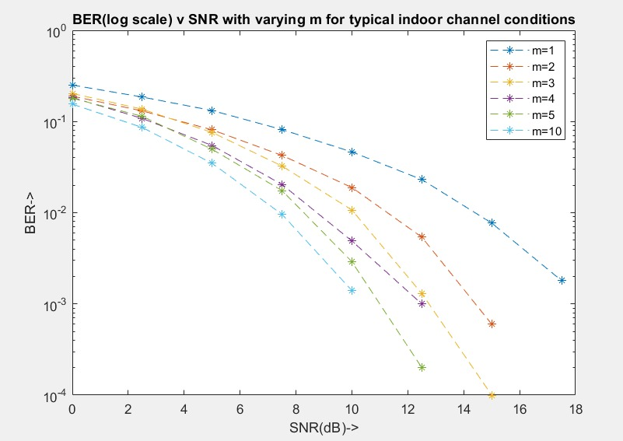
Results
Inference
The assumption of uniform phase (m=1) performs worse than the reality of non uniform phase (m≠ 1) Nakagami channel.

Slide 13
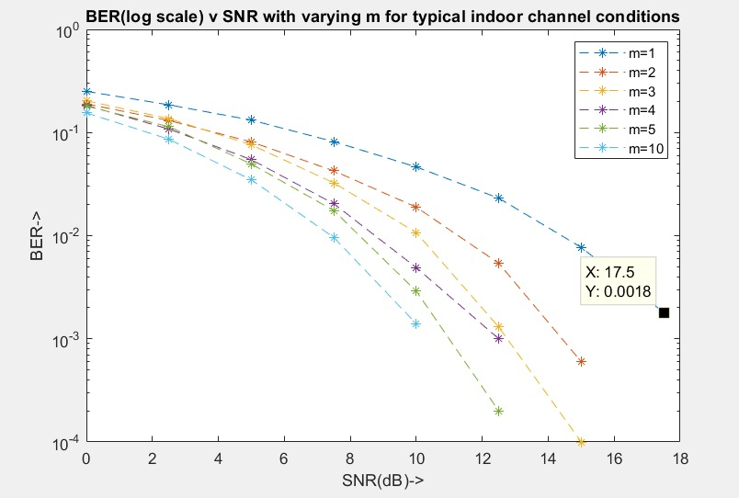
Results
Inference
The minimum possible Bit Error Rate(≠ 0) for uniform phase requires an SNR of 17.5dB.

Slide 14
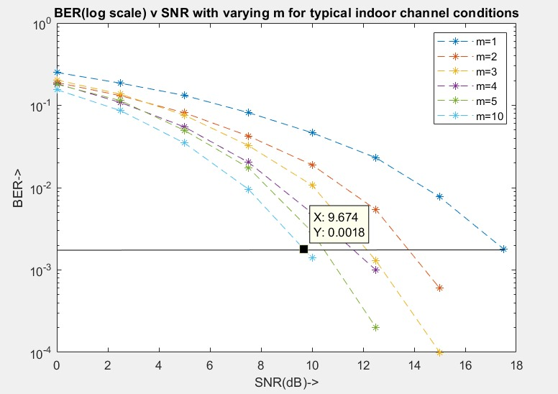
Results
Inference
For the same BER as in the previous slide, non uniform phase (m=10) requires an SNR of 9.674dB.
Thus, improvement in performance is
17.5 – 9.674 = 7.826dB, which is roughly 6.06 times better performance than uniform phase.

Slide 15
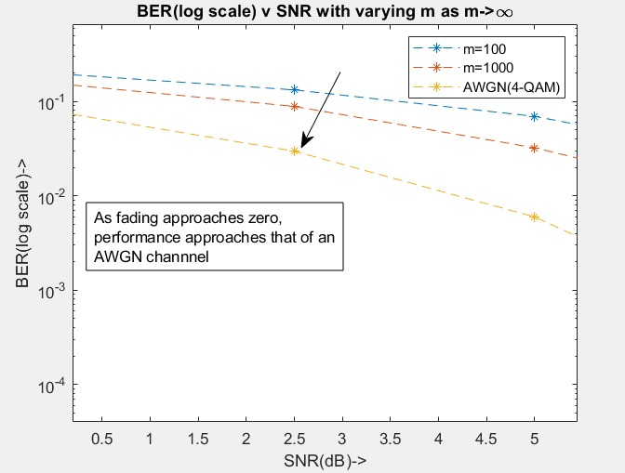
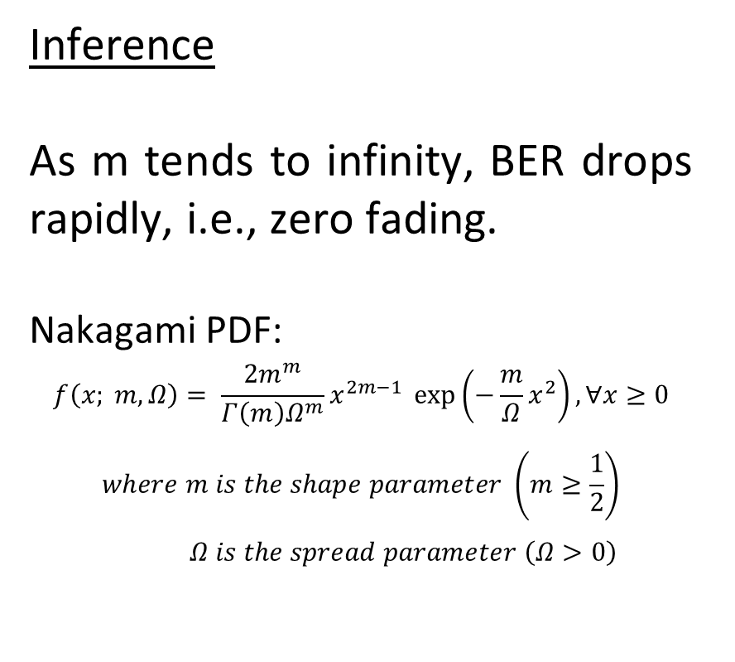
Results
Inference
As m tends to infinity, BER drops rapidly, i.e., zero fading.
Nakagami PDF:
$$f\left(x; m,Ω\right)= \frac{2m^{m}}{Γ\left(m\right)Ω^{m}}x^{2m−1} \exp\left(−\frac{m}{Ω}x^{2}\right), ∀x≥0$$
$$where m is the shape parameter \left(m≥\frac{1}{2}\right)$$
$$Ω is the spread parameter \left(Ω>0\right)$$

Slide 16
Conclusion
The expected results have been achieved, i.e., spatial multiplexing over Nakagami-m channel with m =1 performs worse when assuming uniform phase distribution as compared to the exact phase distribution. And as m tends to infinity, the Nakagami channel becomes Gaussian.

Slide 17
References
1) S. Mohanty, A. Agarwal, S. Mali, G. Misra and K. Agarwal, "Design and BER Performance Analysis of MIMO and Massive MIMO Networks under Perfect and Imperfect CSI," 2020 Fourth International Conference on ISMAC (IoT in Social, Mobile, Analytics and Cloud) (I-SMAC), Palladam, India, 2020, pp. 307-312, doi: 10.1109/ISMAC49090.2020.9243359.
2) Mesleh, R., Badarneh, O.S., Younis, A. et al. How significant is the assumption of the uniform channel phase distribution on the performance of spatial multiplexing MIMO system? Wireless Netw 23, 2281–2288 (2017)
3) Yong Soo Cho, Jaekwon Kim, Won Y. Yang, Chung G. Kang, "MIMO-OFDM Wireless Communications with MATLAB," August 2010, Wiley-IEEE Press.
4) Manamohan, Swathi. "Simulation of Alamouti Coded MIMO Signals over a Nakagami Fading Channel." Electronic Thesis or Dissertation. Ohio University, 2019
5) A. J. Goldsmith, Wireless Communications. Cambridge University Press, 2005.
6) C. Zhong, S. Jin, T. Ratnarajah and K. Wong, "On the capacity of non-uniform phase MIMO nakagami-m fading channels," in IEEE Communications Letters, vol. 14, no. 6, pp. 536-538, June 2010, doi: 10.1109/LCOMM.2010.06.092164.

